Slide 1
AN OVERVIEW OF FIREWALLS
SASHANK NARAIN

Slide 2
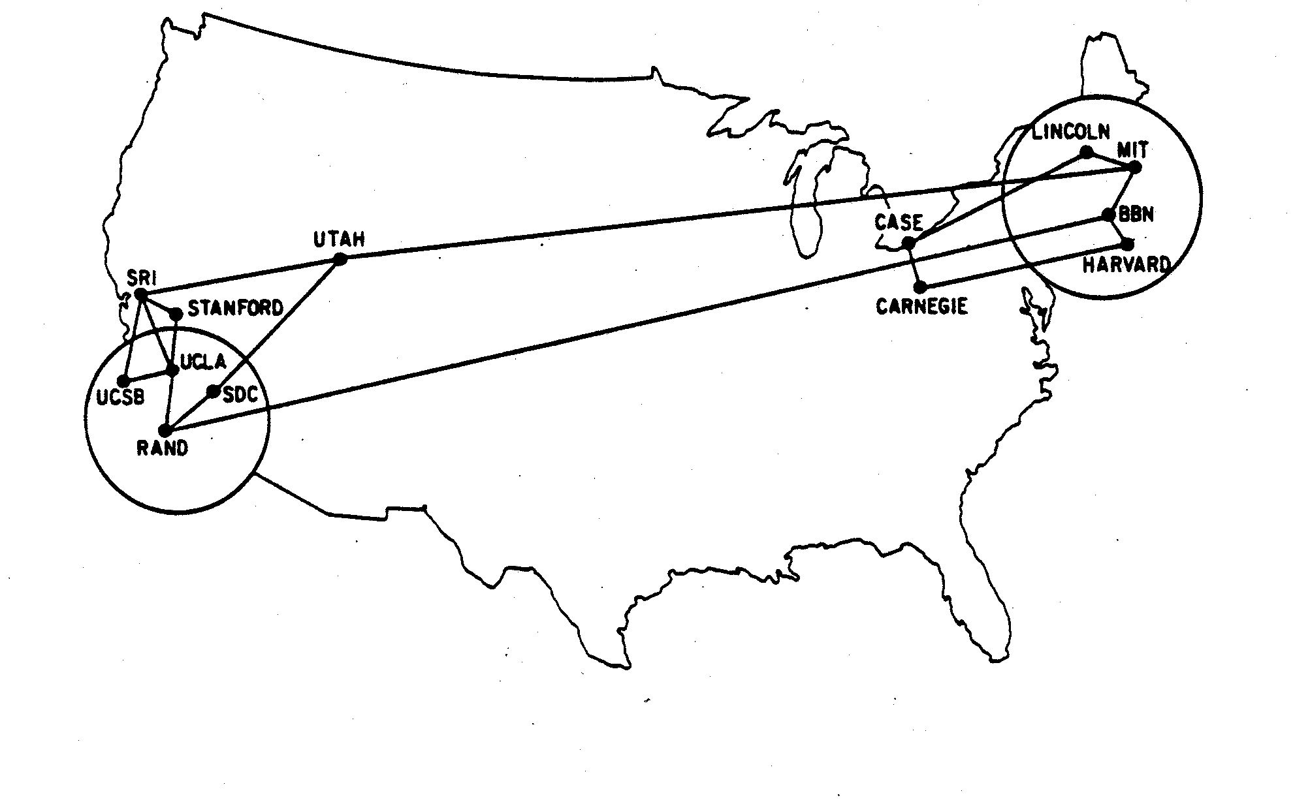
THE INTERNET IN 1970
ARPANET (1970)

Slide 3
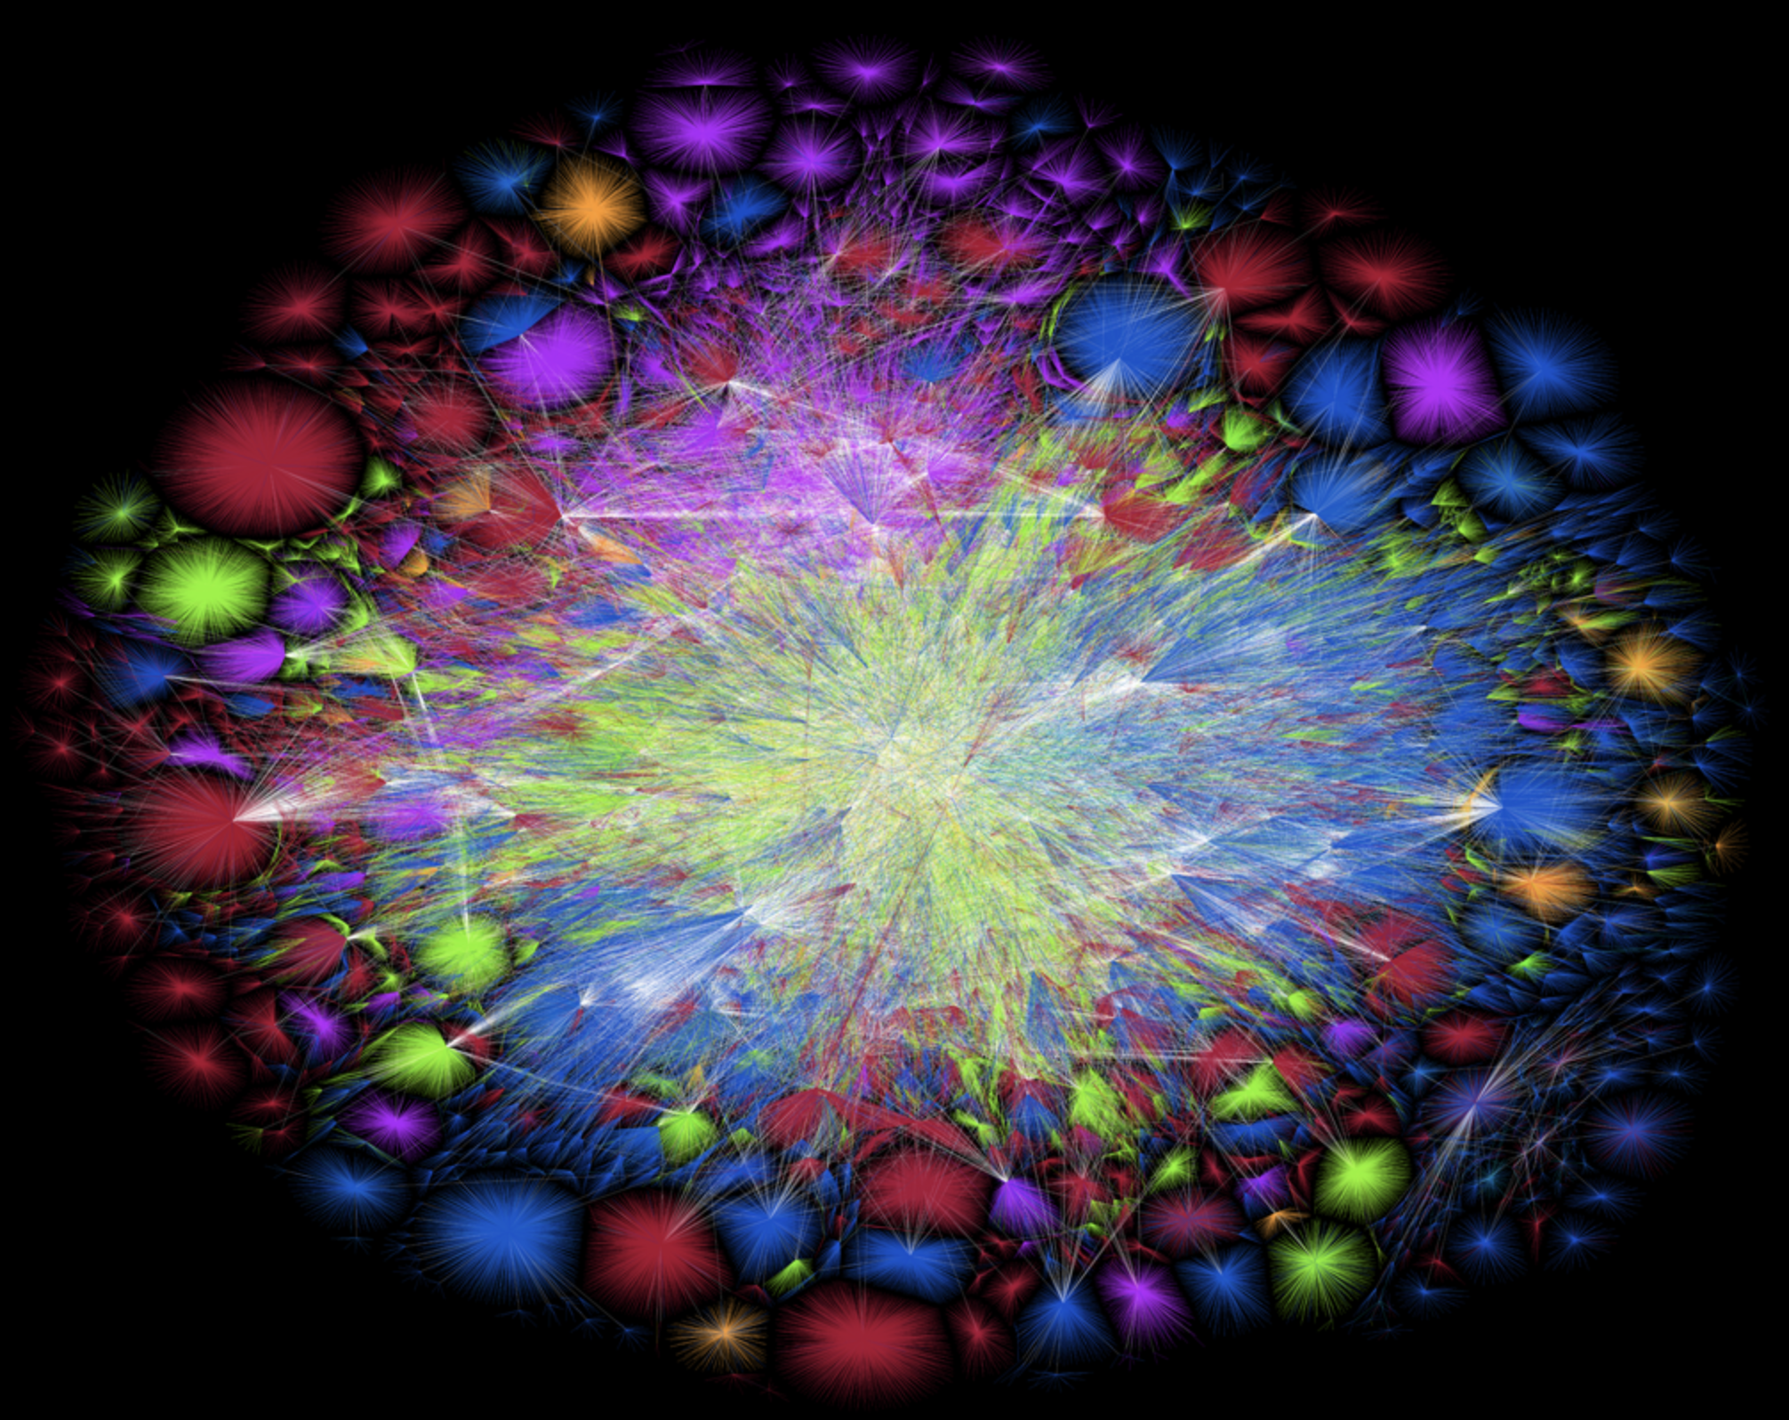
THE INTERNET NOW...
Map of the Internet in 2020
Source: Opte Project

Slide 4
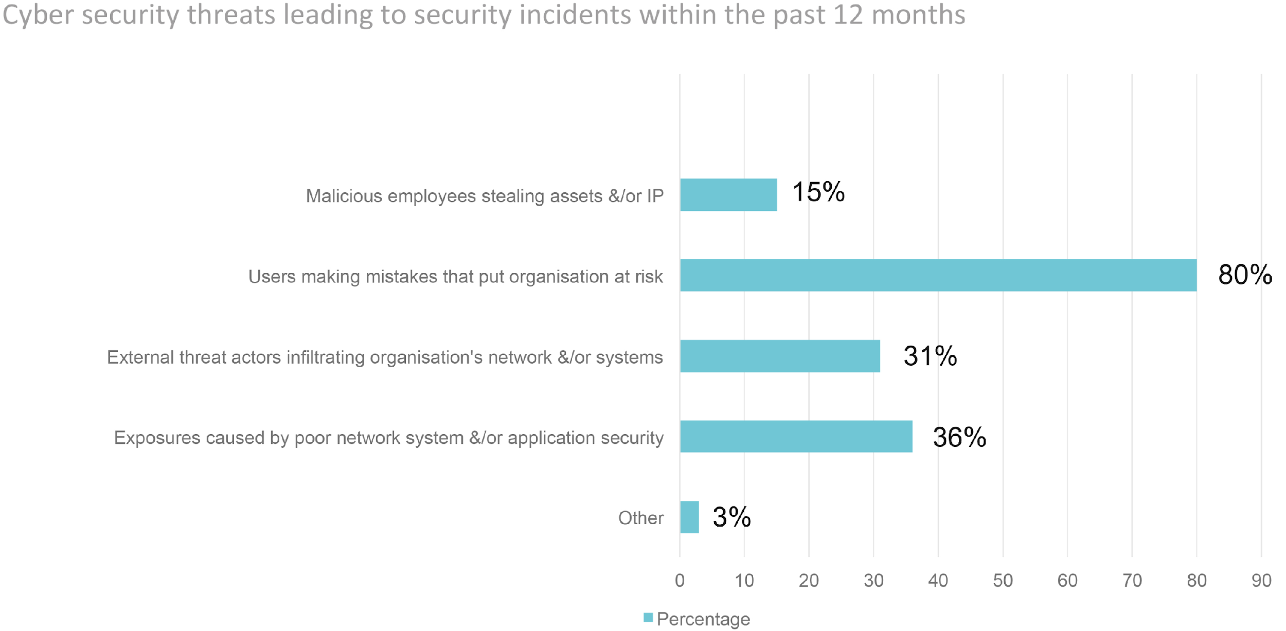
NETWORKS ARE ALWAYS UNDER THREAT
Source: SolarWinds

Slide 5
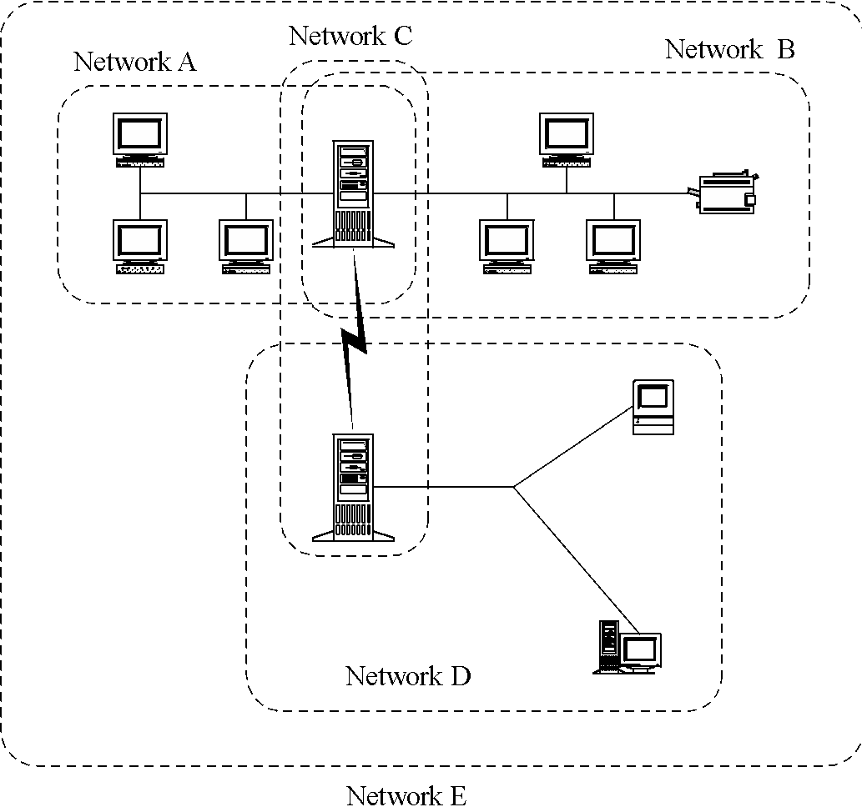

CAUSES OF NETWORK THREATS - UNKNOWN PERIMETER
Networks change all the time
Large networks are difficult to manage
Nodes may be in multiple networks

Slide 6
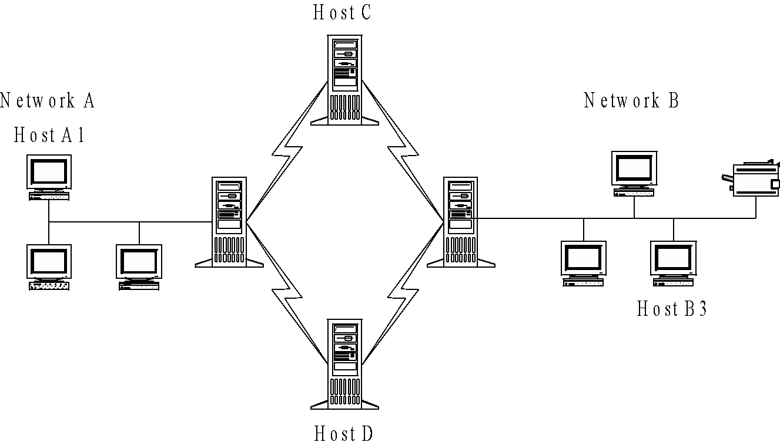
CAUSES OF NETWORK THREATS - UNKNOWN PATH
There may be many paths, including untrustworthy ones, from one node to another

Slide 7
SCANNING A NETWORK FOR AVAILABLE SERVERS
nmap – Very popular open-source network scanner
Scan wide-range of devices in the network
nmap Demo

Slide 8
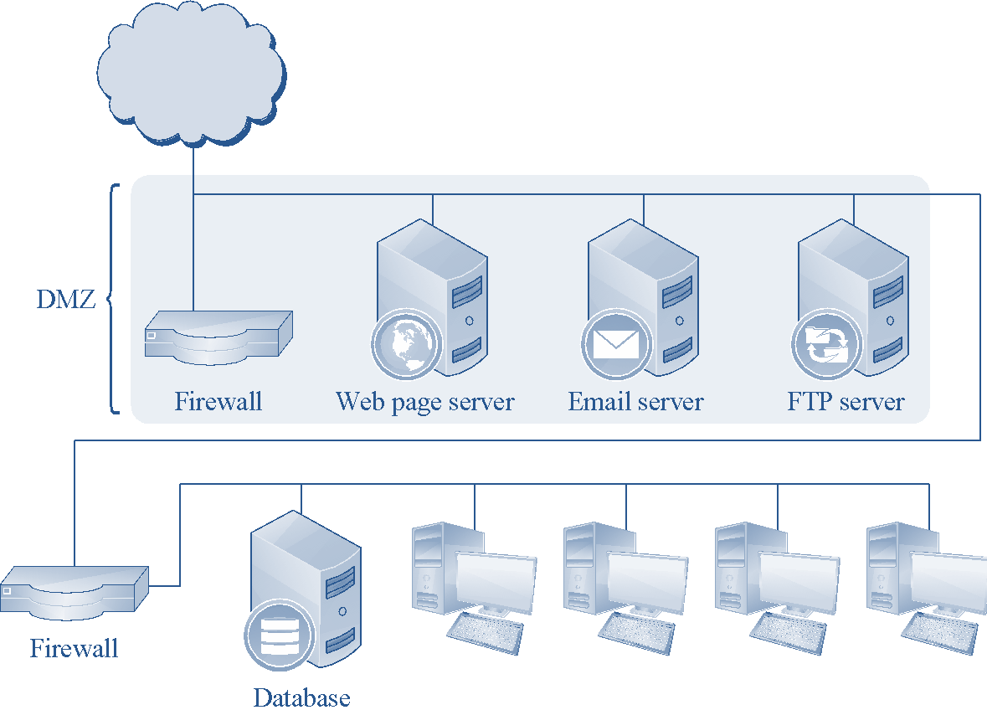
PROTECTION FROM NETWORK ATTACKS
Put nodes into zones based on their sensitivity
Implement a firewall for each zone (Network Firewall)
Implement a firewall on each node (Host-based Firewall)

Slide 9
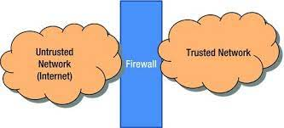
WHAT IS A FIREWALL?
Firewall - A device that filters data between a trusted or “inside” network and untrusted or “outside” network
Defines a set of rules that determine what can or cannot pass through

Slide 10

A REAL-WORLD ANALOGY OF FIREWALLS
Source: https://www.publicdomainpictures.net/en/view-image.php?image=7785

Slide 11
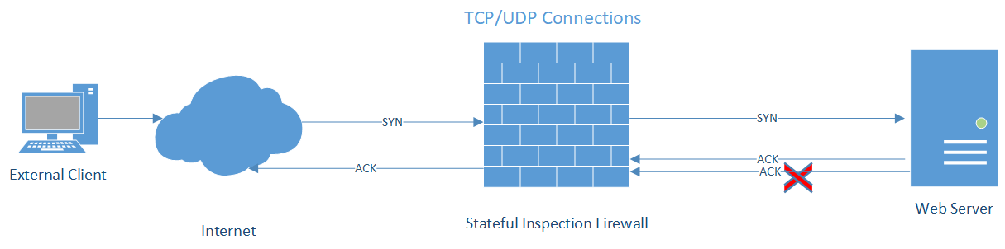
STATEFUL INSPECTION FIREWALL
Most common type of firewall
Firewall decisions based on packet type and state information
States: related, established
Notes:
** Whiteboard – Packet vs Stateful

Slide 12
EXAMPLE OF A STATEFUL INSPECTION FIREWALL
Assuming X is the IP address of a node
Rule No | Protocol | Source IP | Destination IP | Destination Port | Action
1 | TCP | Any | X | 22 (SSH) | Allow
2 | UDP | X | Any | 53 (DNS) | Allow
3 | TCP | X | Any | 80 (HTTP) | Allow
4 | TCP | X | Any | 443 (HTTPS) | Allow
5 | Any | Any | Any | Any | Deny

Slide 13
LINUX UNCOMPLICATED FIREWALL (UFW) EXAMPLE
$ ufw default deny incoming
$ ufw default deny outgoing
$ ufw allow in 22/tcp
$ ufw allow out 53/udp
$ ufw allow out 80/tcp
$ ufw allow out 443/tcp
$ ufw enable
Rule No | Protocol | Source IP | Destination IP | Destination Port | Action
1 | TCP | Any | X | 22 (SSH) | Allow
2 | UDP | X | Any | 53 (DNS) | Allow
3 | TCP | X | Any | 80 (HTTP) | Allow
4 | TCP | X | Any | 443 (HTTPS) | Allow
5 | Any | Any | Any | Any | Deny

Slide 14
LINUX UNCOMPLICATED FIREWALL (UFW) DEMO
UFW Demo

